Slide 1
Welcome!

Slide 2
How to Edit or Delete a Post on Your Auxiliary Facebook Page

Slide 3
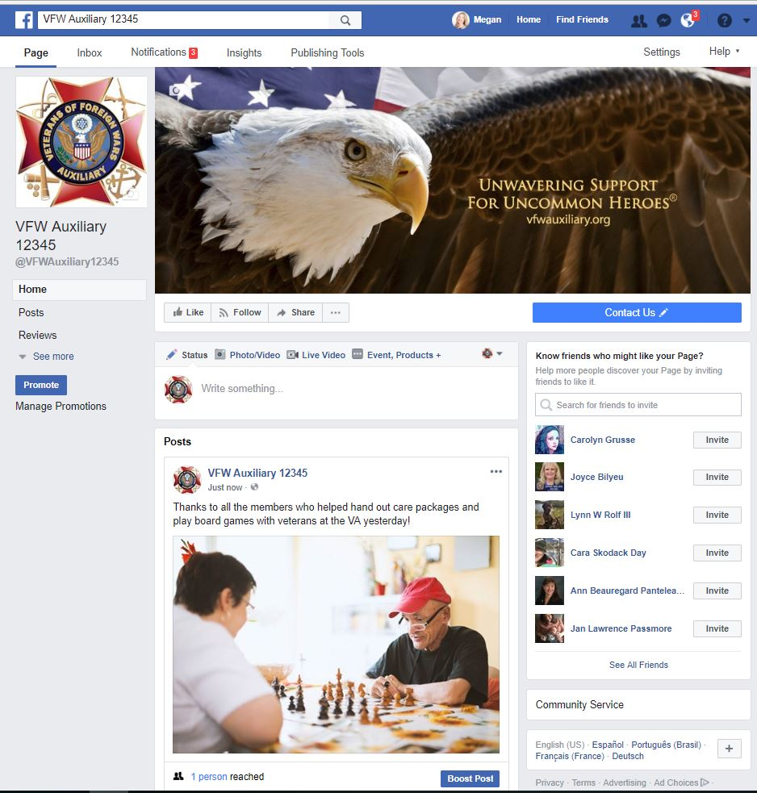
A post has been published.
What if a mistake was made or the post needs to be removed?

Slide 4
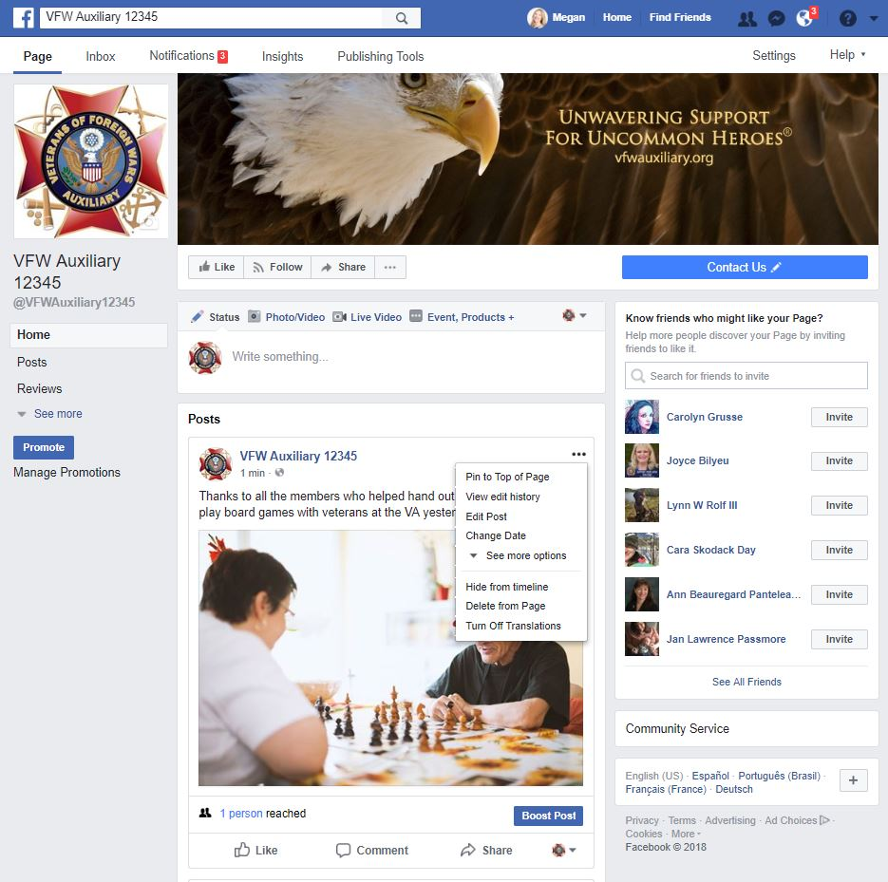
Select the “Three Dots (…)” in the upper right-hand corner of “Posts” - it will be close to the Auxiliary name.
From the drop-down menu, select “Edit Post” to edit the post or “Delete from Page” to delete the post.

Slide 5
To edit a Post, select the “Three Dots (…)” in the upper right-hand corner of “Posts” - it will be close to the Auxiliary name.
From the drop-down menu, select “Edit Post.”

Slide 6
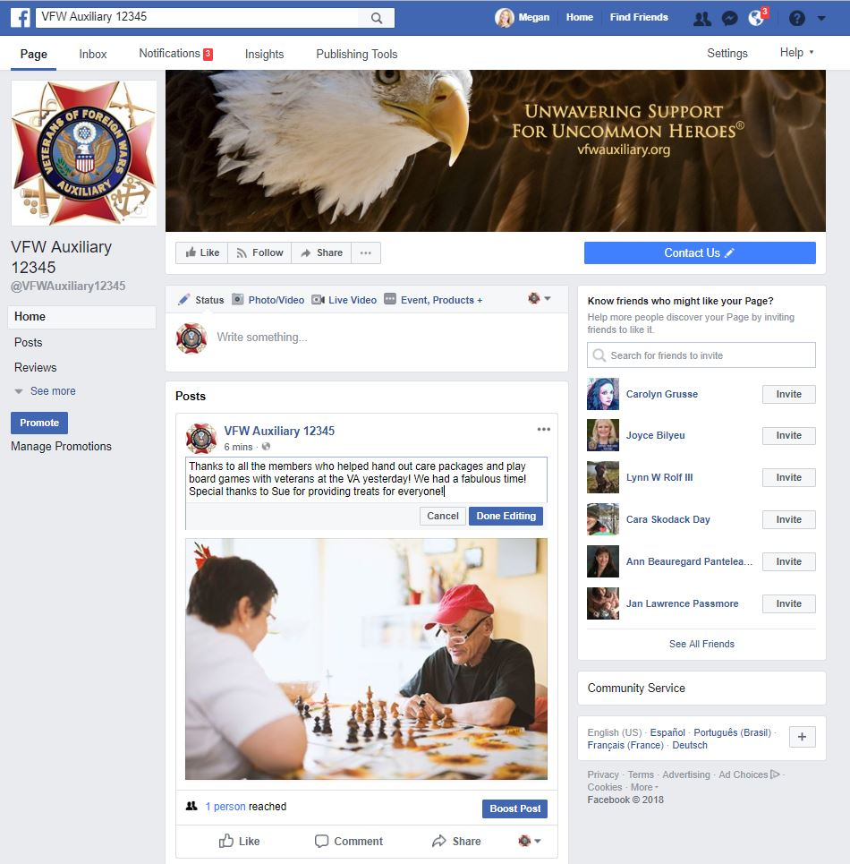
Make the changes and click the “Done Editing” button when completed.

Slide 7
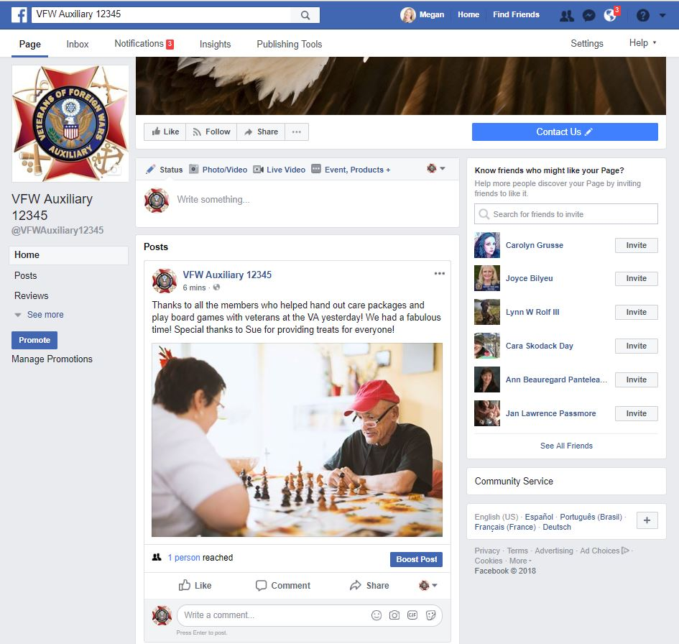
The edited post will display.

Slide 8
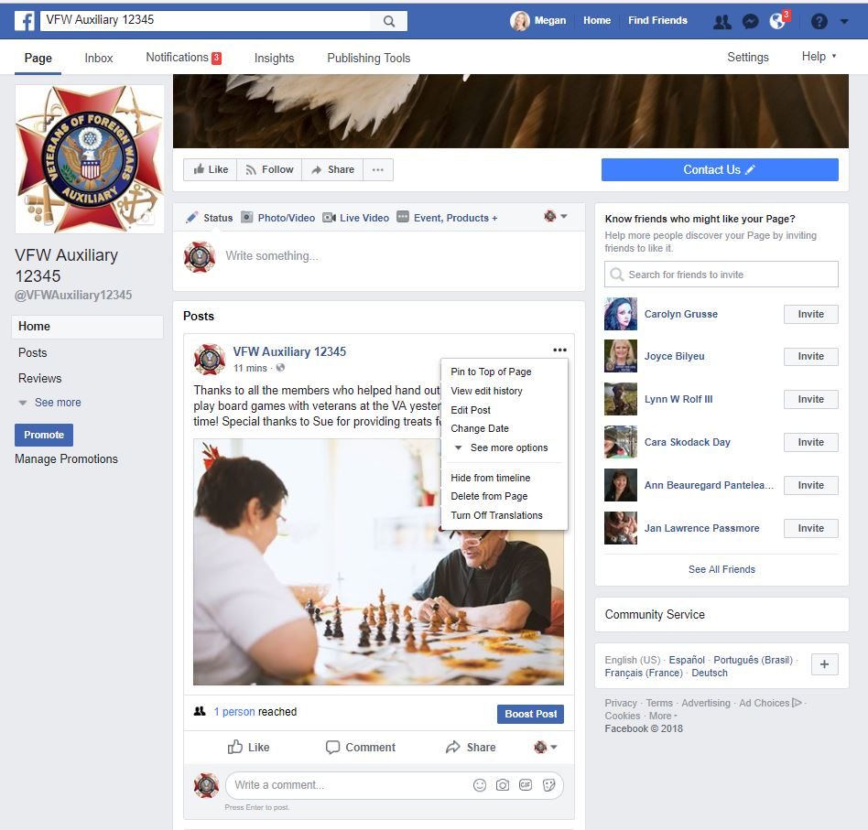
To delete a post, select the “Three Dots (…)” in the upper right-hand corner of “Posts” – it will be close to the Auxiliary name.
From the drop-down menu, select “Delete from Page.”

Slide 9
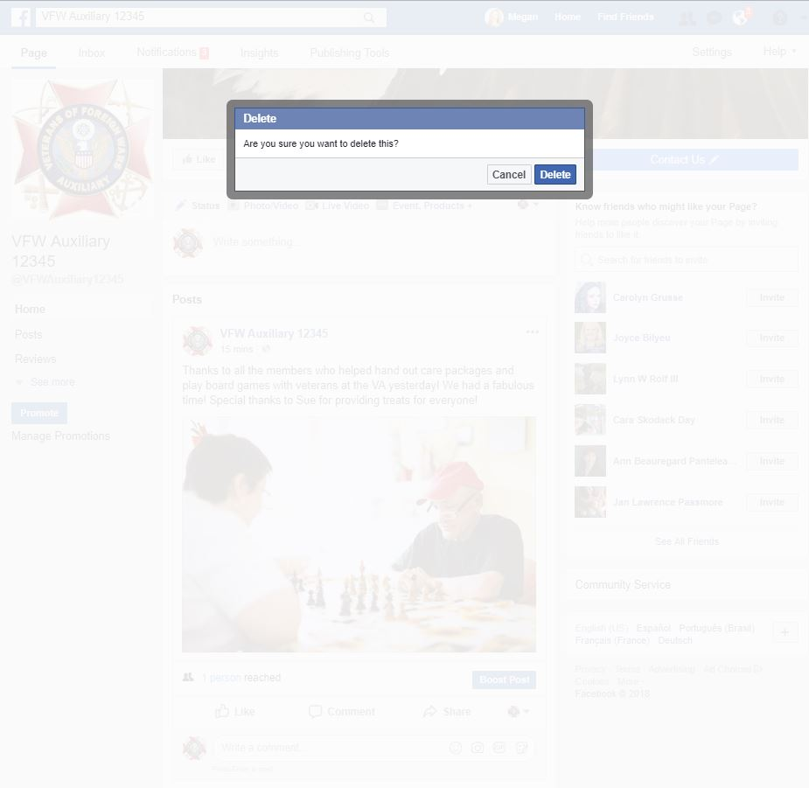
A pop-up box will appear to verify you want to delete the post. If so, select the “Delete” button. If not, select the “Cancel” button.

Slide 10
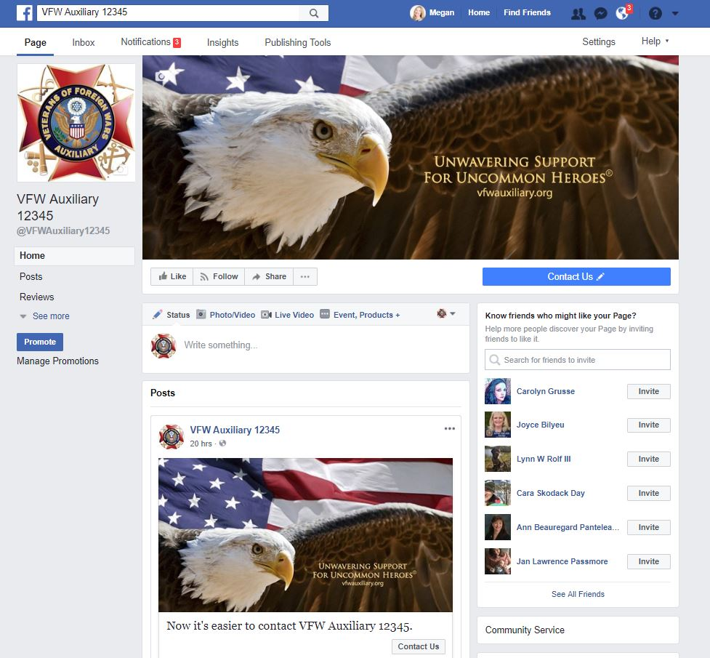
If the “Delete” button was selected, your Auxiliary page will display with the post removed.

Slide 11
Questions?
Contact Megan Zinn-Sanchez
Public Relations & Marketing Coordinator
VFW Auxiliary National Headquarters
mzinn-sanchez@vfwauxiliary.org

